Slide 1

Capstone Final
ETHNIC RESTAURANTS IN Manhattan
Mohsin nathani

Slide 2
Business Case
Many restaurants that offer different types of ethnic cuisines are located in different parts of the New York City, especially Manhattan. Especially where that certain ethnicity may be more present than in other parts of the city, or when similar businesses are in that part of the city. This data is very pertinent to small business owners thinking of building their very first restaurant, or even a new location their franchise or business.
How can a restaurant/franchise consulting firm work with data to show where new restaurants should open based on the regions and neighborhoods in the New York City Metro Area, and the type of cuisine they carry?
As a potential business owner in a new city, you want to have your location next to similar business for many reasons. Having several competitors in one place is great for customers, and other competitors automatically provide traffic and customers. Not only that but similar ethnicities to your type of cuisine may be in the same area, amongst competitors - which will help boost customer attention.

Slide 3
DATA
Data to Collect
1. Foursquare: Manhatten restaurants and their type of cuisine
2. Folium: Maps to understand proximity.
3. Due to Limit on FourSquare search, Was only able to pull 100 locations for each category within 2000 meters of Manhattan City Center
4.Cluster and segment data by creating their own regions

Slide 4
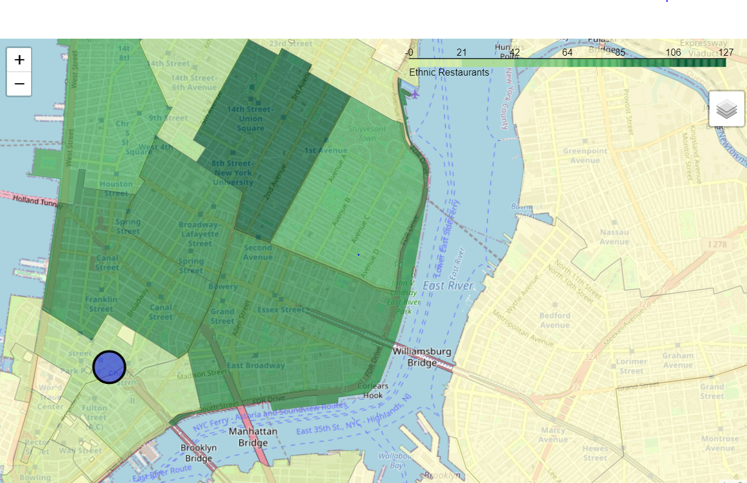
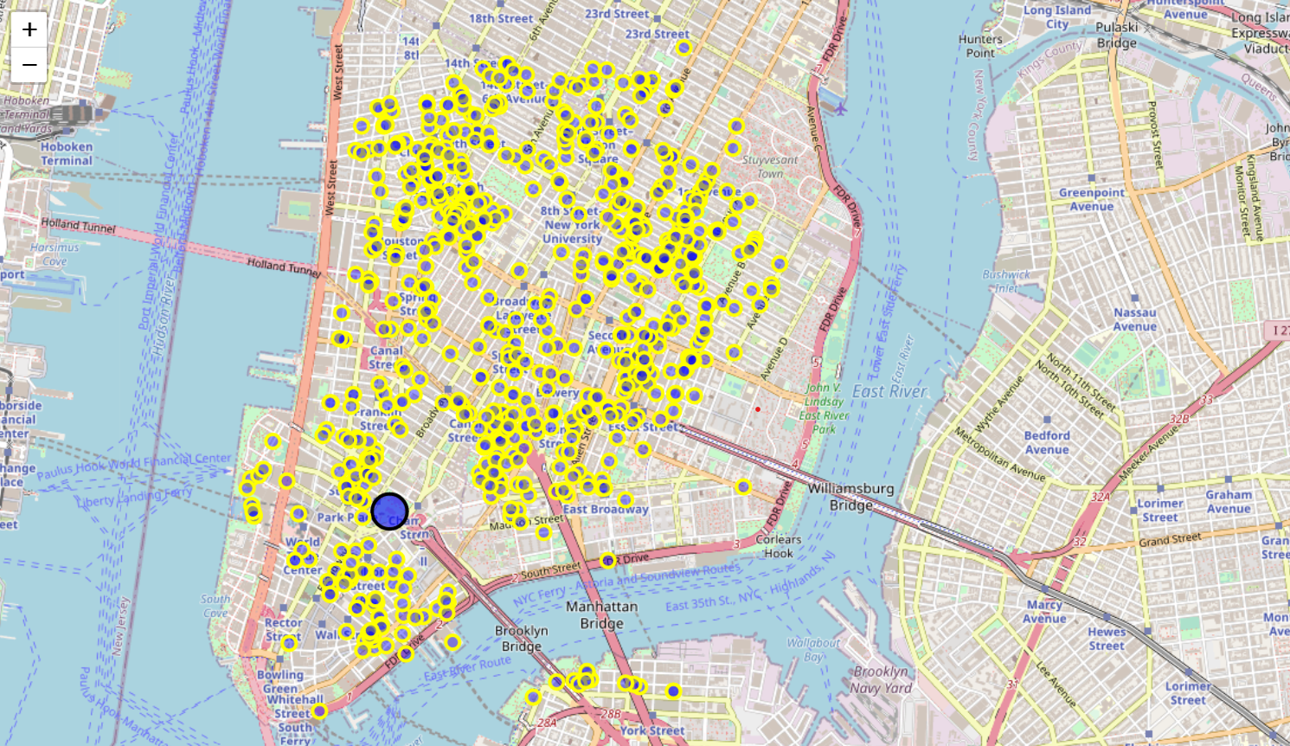
MAPS

Slide 5
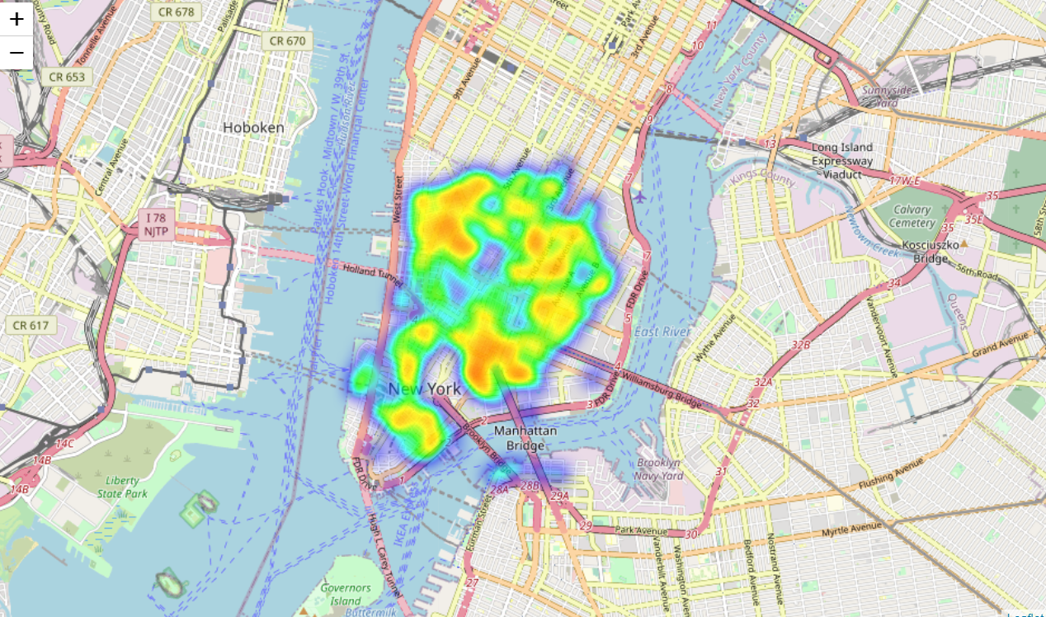
Heat Map of Concentration

Slide 6
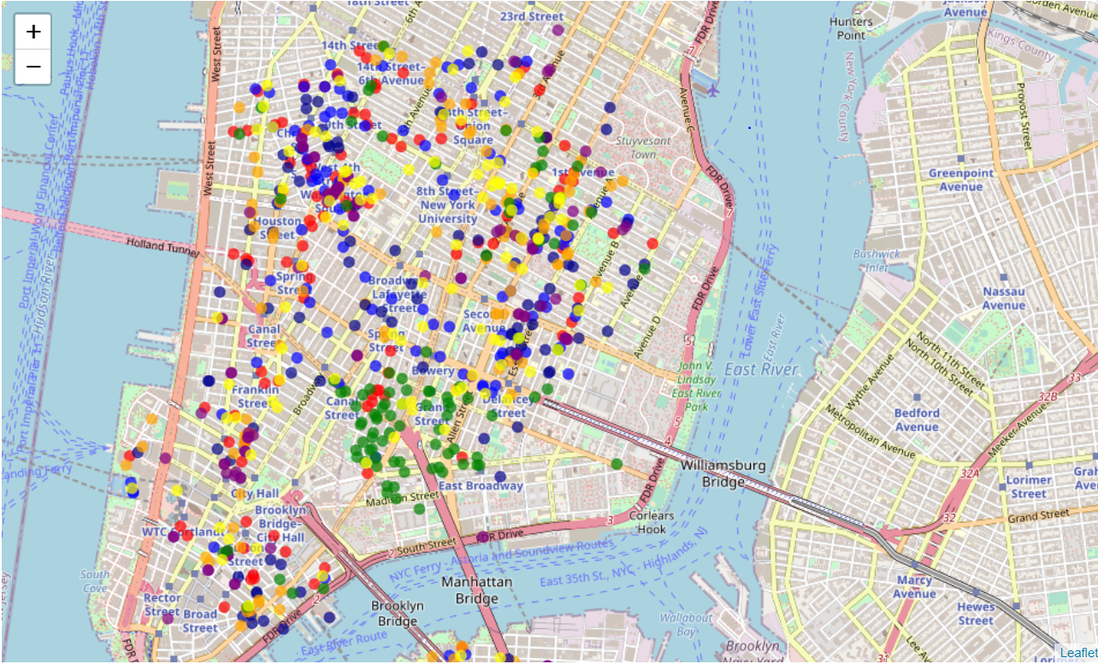
Map by Category

Slide 7
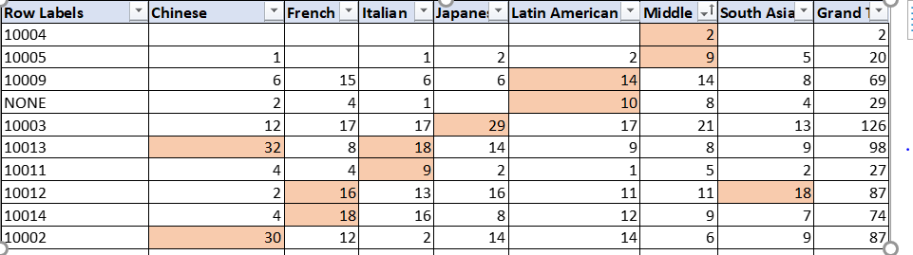
Conclusion Chinese: Southeastern Manhattan French: Broadway and North Houston Street Japanese: 8th Street NYU area Italian: Houston Street, Spring Street, and 14th street Latin American: Bowery, East Houston, Delancey Street South Asian: Chambers Street Park Place, City Hall Middle eastern: Chambers Street, Reade Street
We see below with the data provided that There are certain zip codes and geographical locations that fit certain types of international cuisine. For Chinese, there are less areas but with a higher velocity of shops, followed by Italian and South Asian.

Slide 8
Thank You

